Slide 1
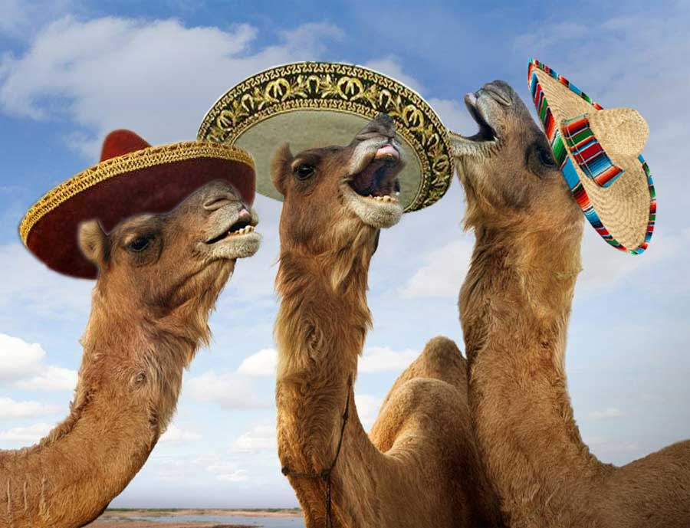
CAMELS
Not this kind!

Slide 2
What does it stand for?
Camera
Acting
Mise en scene
Editing
Lighting
Sound

Slide 3
Camera
The three main elements of camera are:
Shots
Angles
Movement
Let’s start by looking at shots

Slide 4
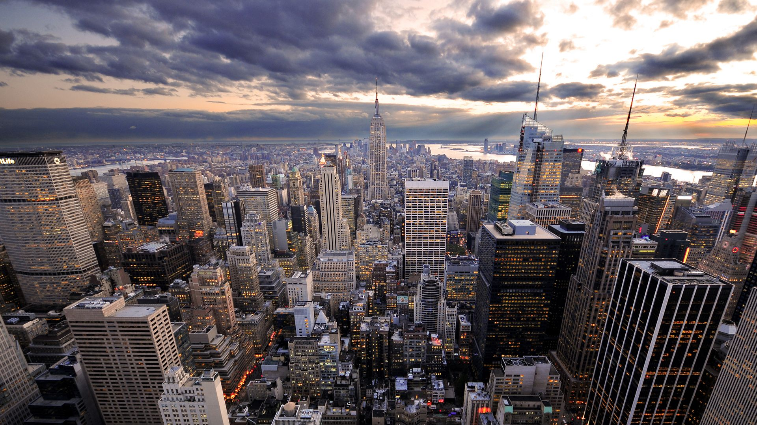
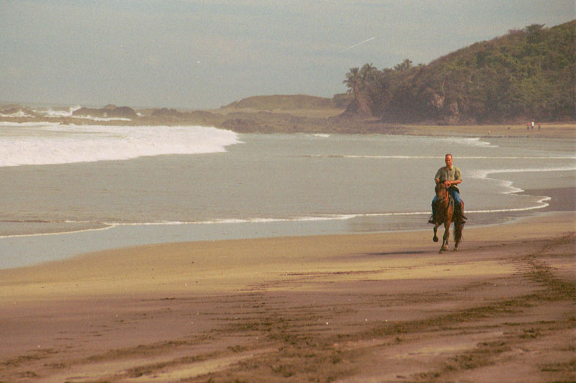
extreme long shot
(also sometimes called an establishing shot)
Often used at the beginning of a scene to show where the scene will take place.
In a long shot, it is usually possible to discern individuals but there is also a great deal of background.
long shot

Slide 5
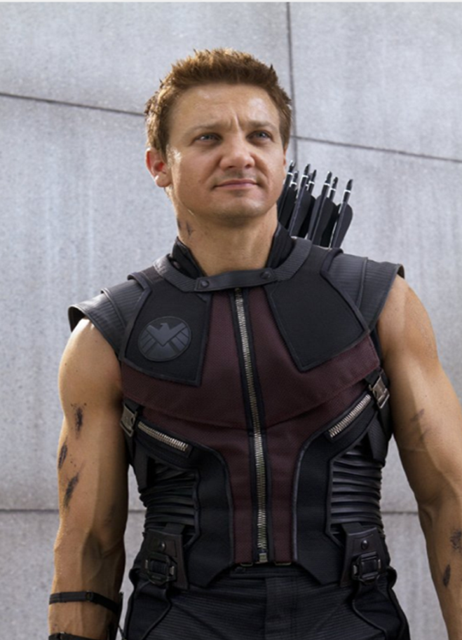
full shot
A full shot shows a character from head to toe.
Often used when filming conversations. Show character from waist (mid) up.
It is one of the most frequently used shots in film and TV.
mid shot

Slide 6
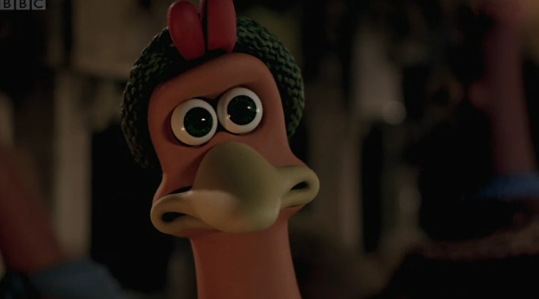
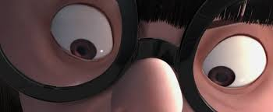
A close up usually shows a character’s face.
(Often used when shooting conversations, this is also one of the most frequently used shot sizes in film and television.)
close up
extreme close up
Used to show small details.

Slide 7
Angles
Overshot: Camera is positioned directly above the subject.
High Angle: The camera is positioned above the subject, looking down at an angle. This aims to make the subject appear smaller, powerless and more vulnerable.
Eye Level: Most commonly used camera angle. Creates a sense of normalcy because it is how we see the world.
Low Angle: Camera positioned below eye level, looking up, to imply a sense of power and dominance.
Undershot: The camera is positioned directly beneath the subject, looking up. Often coupled with point-of-view shots when the character is looking up at something.

Slide 8
Meet Chloe
By yourself: Label each picture with the type of camera angle used
When you are done, swap with a partner.

Slide 9
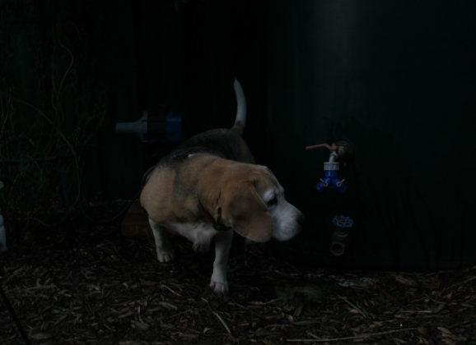
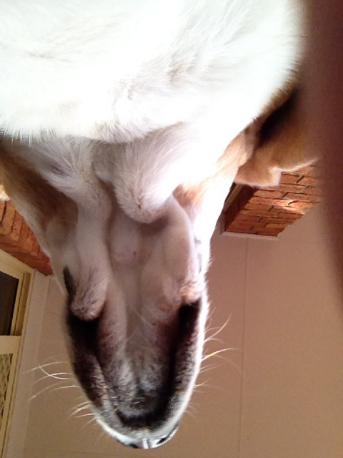
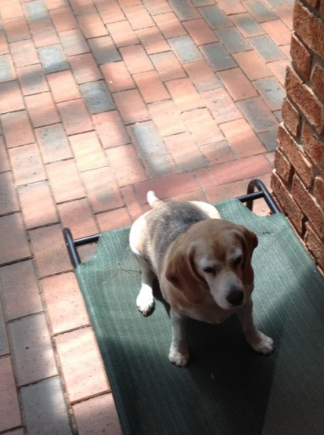
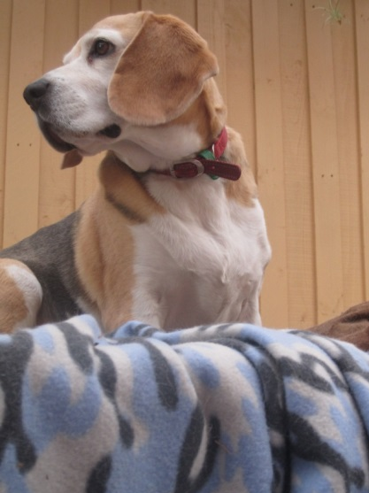
Under Shot
Eye Level
High Angle
Low Angle
Over Shot

Slide 10
Movement
Static
Pan
Tilt
Dolly
Crane
Handheld
Steadicam
Zoom
Tracking shot
Point of view shot

Slide 11
Touch of Evil (1958)
What kind of camera movement can you spot?
Jot some things down while you watch!
http://www.youtube.com/watch?v=Yg8MqjoFvy4

Slide 12
Acting
http://www.youtube.com/watch?v=R7m5Int1hAA
Things to think about with acting:
Movement
Gesture
Voice
How do these construct a character?

Slide 13
Mise en scene
French term that means “placing on stage.”
The arrangement of everything that appears in the frame (scene)
Actors, lighting, décor, props,

Slide 14
Editing
Editing is was brings a film together, all the filming, casting choices, and weeks, months, years of planning can come down to how well a film is edited.

Slide 15
Editing
Edit: any change in camera shot
Transition: a change in scene or time/location
Main types of edits/transitions: cut, fade, dissolve, wipe, clock wipe
http://www.youtube.com/watch?feature=player_detailpage&v=-BrDlrytgm8

Slide 16
Remember:
Editing should be seamless and carry meaning.
Bad editing draws attention to itself and takes away from the narrative.
It creates a barrier between the audience and the story.

Slide 17
Lighting
Hard/Soft light
Key Light
Fill Light
Back Light

Slide 18
Key Light
The main source of light in a shot or scene.
Sparkles and Wine:
http://vimeo.com/63602119

Slide 19
Fill Light
Light used to make shadow a little bit more visable

Slide 20
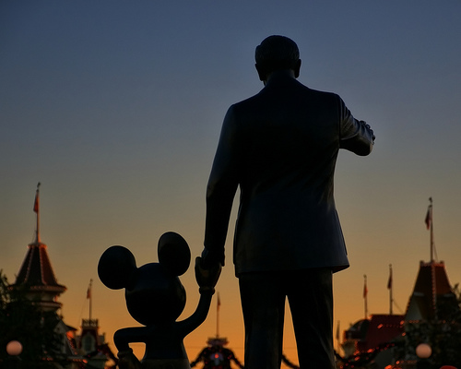
Back Light
Light is behind the subject, subject is in shadow
Sense of darkness/ mystery

Slide 21
Sound
Diegetic: This is all the sound that the character would hear. It is the sound IN the film.
Non-Diagetic: This is the sound that the audience can hear, but not necessarily the character. Sound track, special effects etc.

Slide 22
Watch this clip
What kind of sound is used?
What does the sound tell us about what we should expect?
(Possible clip from The Princess Bride)

