Slide 1
DARK ROOTS REVISION
By Cate Kennedy
REVISION

Slide 2
THE COLLECTION AS A WHOLE
Secrets
Things hidden from view
Concealment
Darkness
Communication
Human condition …”there is some hidden grief here I need to declare, and my fingers itch for a pencil..”

Slide 3
TONE
Melancholy
Exact turn of phrase
Malaise of everydayness
Stuck, stagnant, marking time
Frustration
Honest

Slide 4
CONNECTIONS
Characters in a time of crisis , desperation
Epiphanies
Loss, trauma
Turing points
Choice and consequences
Balance between self actualization, freewill and fate
Human condition
Communication

Slide 5
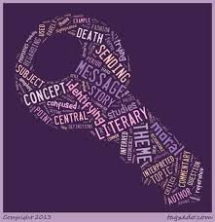
LITERARY TECHNIQUES
Metaphor and Extended Metaphor
Contrast / juxtaposition
Foreshadowing
Mood, tone, atmosphere
Motif
1st, 2nd 3rd person narrative structure
Pathos
Personification

Slide 6
WHAT THOU AND I DID TILL WE LOVED
Rebecca sits in a hospital room, waiting for her partner Beth to emerge from a coma
Symbiotic nature of relationship
Love – connection, disconnection
Chance
Choice – how do I go on? Can I go on? Death with dignity
Pathos, sadness, frustration
Motif of food – nourishment, sustainance,
Ist person

Slide 7
A PITCH TO HIGH FOR THE HUMAN EAR
Andrew becomes disconnected (eventually divorced) from family because he is unable to articulate his feelings to his wife and children.
Difficulties of facing reality, shortcomings
Communication – inarticulate male, withholding the truth, not facing reality, finding your voice
Empathy, pathos
Motif – hearing, sound
1st person

Slide 8
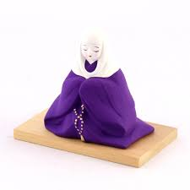
HABIT
Unnamed woman is returning from Columbia with a kilo of drugs hidden in bags, to be used as treatment for incurable cancer. She is disguised as a nun.
Motif – Religion – Catholicism – Blessed – puns
Secrets
Death – with dignity
Tension, suspense, relief
1st person - Internal monologue
Humour

Slide 9
FLOTSAM
An elderly woman returns to her home town, to reflect on her life after she left, pregnant and abandoned by the father of her child
Memories – the past – guilt – nature of memory
Escape – limited small town life – women
Symbolism – the sea as life and death – circle of life – flotsam and jetsam
2nd and 3rd person

Slide 10
COLD SNAP
Billy lives in an isolated rural setting with his father. New neighours move in from the city and threaten the environment and his peace of mind
Revenge
Mother Nature, protecting Mother Earth, exploitation
Prejudice, judgment
Communication – voice
1st person

Slide 11
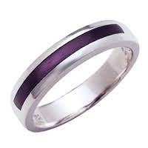
RESIZE
A married couple reconnect after realising that their too tight wedding rings may symbolise wider aspects of their life
To resize, change, adjust, reboot, renew
Symbolism – wedding rings, car (unreliable old bastard)
Past and the future – reconciliation
Mood – tension and release
3rd person

Slide 12
THE TESTOSTERONE CLUB
Monica realises she needs to leave an unhappy, limited and unfulfilling marriage
Metaphor – Testosterone Club – male arrogance, self importance, self absorption, cliched stereotypical Aussie male
Choice
Revenge - preserves
1st person

Slide 13
DARK ROOTS
Depicts the inner turmoil of a 39 year old woman who is dating a 26 year old man
Title story of the anthology
Secrets – things hidden
Ageing - Time cant be challenged
Self worth – Pressures of beauty – of being female – societal expectations
Tone – furious, scathing, frustrated, on the edge
Her feelings of pressure, fear, paranoia, eventually sabotage the relationship
2nd person

Slide 14
ANGEL
The traumas of a Vietnamese refugee and her daughter as she battles for a safe haven on her journey to, and once she arrives in Australia
Pathos – empathy – trauma
Revenge – avenging angel – guardian angel
Motif - Communication – speech – silence – voice
Belonging
1st person

Slide 15
SEIZURE
Helen reconsiders her life and her relationship with her partner after witnessing an epileptic seizure in the street.
Humanity – selfishness – selflessness
Relationships – personal space - change – growth
Reflection
Foreshadowing – first half of the story mirrors the second
1st and 2nd person

Slide 16
THE LIGHT OF COINCIDECE
A number of coincidences occur in a man’s life, leading him to the $700 he needs.
Coincidence – providence – fate – luck – karma
Choices – moral - immoral
Synchronicity
A reflection on life and its meaning – it needs to be solved, just as a jigsaw puzzle
1st and 2nd Person

Slide 17
SOUNDTRACK
Rachel reflects on her life and her relationship with her daughter when she discovers that she is pregnant
Living in the past and the present
Motif – musical soundtrack – film techniques – yin and yang
Age – Fate – Monotony – repetition – marking time – looking for meaning – connection
3rd person

Slide 18
DIRECT ACTION
An unemployed welder becomes an ‘eco-warrior- when he takes “direct action” against a paper mill that is polluting the local environment
Relationships – father and son
Self esteem
The law – justice - principles
Development v’s environment
Ist person

Slide 19
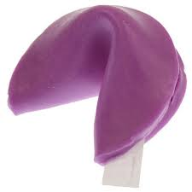
THE CORRECT NAME OF THINGS
Ellen works in a Chinese restaurant during the 1980’s where she realises that she needs to find herself a more purposeful existence
The importance of looking deeply – leading a meaningful life – education v’s life experience,
Retrospective view of the past – one stage in the narrator’s life
Motif – food - fortune cookies – sustenance and community
Things are rarely as they seem
Ist person

Slide 20
WHEELBAROW THIEF
Stella is a beautiful, intelligent publicist who is reduced to a dinner party accessory by her partner – she has prepared food for the party – going to great lengths – and realises that she is not appreciated in the relationship and does not want him in her life anymore – suffers a miscarriage
Motif – food – zen parable
Secrets
Objectification of women – relationships – communication – self actualisation – inner strength
3rd person

Slide 21
SEA BURIAL
When burying her husband (a drug trafficker) an unnamed narrator reflects on the emptiness of her life, and the tragedy of her daughter’s life at the hands of drugs
Secrets – things hidden
Tragedy – the evil of drugs
Motif – the sea – the giver and taker of life – flowers
Detachment – relationships – guilt
Ist person

Slide 22
KILL OR CURE
Helen finds it difficult to adjust to her new life, when she marries a farmer and moves to the country
Change and adaptation – ‘put up or shut up’
Monotony – stagnation – frustration – isolation – reality
Communication
Choices – and living with them
Motif – hardness and softness – physical & emotional v’ unwavering pragmatism
Extended metaphor – Helen is treated in much the same way as the dogs – aversion therapy
2nd and 3rd person

