Slide 1
Encountering
conflict
“Use texts as vehicles, not as the centre of the task” Examiners’ Report – 2009, p8

Slide 2
What is conflict?
Are there different kinds of conflict?
When might conflict be ‘encountered’?
(Make brief notes in your notebook)

Slide 3
What kind of conflict is this?
What could exacerbate conflict /s here?
Is there more than one kind of conflict?
What might alleviate or resolve the conflict/s?
What might be the causes of conflict/s?
What might be the consequences of conflict/s?

Slide 4
What kinds of conflicts occur within ourselves and in our personal relationships?

Slide 5
What kind of conflict might be occurring here?

Slide 6
What kind of conflict might be occurring here?
What’s the relationship between differ-ence and conflict?

Slide 7
What kind of conflict is involved here?

Slide 8
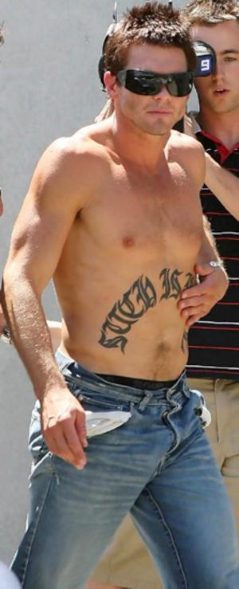
Who is this and what is tattooed on his body?
Why might he have chosen these words?
With whom is he in conflict?
How has he dealt with the tensions, pressures and expectations he has encountered?
What role might the photographer have in the conflict?

Slide 9
What kind of conflict might be occurring here?

Slide 10
What kind of conflict might be occurring here?
Does inner conflict (sometimes / always) lead to confrontation with others? Why?

Slide 11
Who is encountering conflict here?

Slide 12
The following 2 slides show the ways in which conflict has been analysed by psychologists and sociologists:
What do they suggest about the ways that human beings interact with each other?
Is anything being implied about our basic human nature?
What is not being shown about human nature and our relationships?
What is your view about the connection between human nature and conflict?

Slide 15
The following slide makes some assertions about the relationship between human beings and their environment.
What assumptions are being made about our priorities and values?
Do you support or challenge these assumptions? Why?

Slide 17
What opposing forces have created this conflict?

Slide 18
What opposing forces have created this conflict?

Slide 19
What opposing forces have created this conflict?

Slide 20
What opposing forces have created this conflict?

Slide 21
What kinds of conflicts occur when people’s values and interests clash?
What sets of values or interests are clashing in the following six slides?

Slide 22
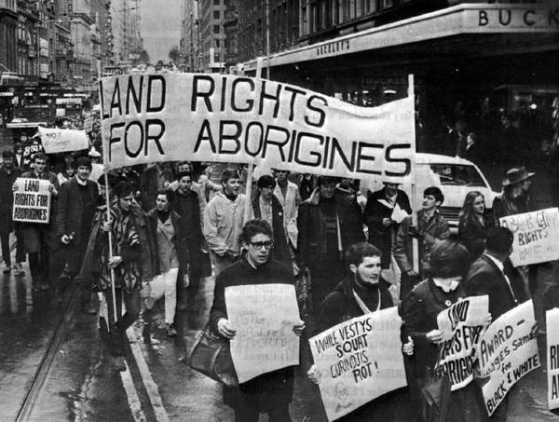

Slide 27
Identify some of the opposing values driving these conflicts

Slide 28
Reflect on why conflict has arisen from these opposing values.
Is there a connection between the personal and the political?
Can conflict result in change rather than confrontation?
Consider the following 2 slides:

Slide 29
What kind of conflict might be involved in human evolution? an
Have the outcomes of conflict been positive or negative?

Slide 30
Is there a suggestion of conflict in human beings’ journey from savagery to civilisation? What kind of conflict – and why might it occur? Do civilised people have anything in common with their savage ancestors? Is there conflict between our savage and civilised selves?

Slide 31
Is
Competition or conflict?
What competing or conflicting values are involved?

Slide 32
Competition or conflict?
Does ‘victory’ over an opponent always resolve conflict?

Slide 33
Does conflict create ongoing tensions ... and how might these be productive?

Slide 34
How might ongoing tensions be counter-productive?
What role might gender play in the way conflict is encountered?

Slide 35
Conflict can also arise from misunderstandings or differing perceptions; consider the following slides and reflect on why conflict has occurred.
There are often personal and social factors which increase tensions and cause conflict

Slide 36
What differing perceptions might be operating within opposing groups here?

Slide 37
What kinds of historical, social and cultural issues might create and exacerbate conflict?

Slide 38
Is this where conflict is leading us?

Slide 39
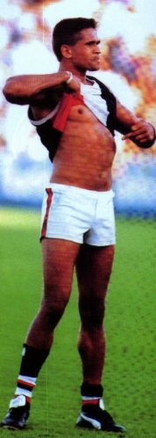
Is there a connection between values and identity?
Does a challenge to our values make them stronger?
Does a strong commitment to our own values inevitably lead to an intolerance of others’ values?

Slide 40
What kind of conflict is depicted here? Is it an irresolvable one? Why (or why not)?

Slide 41
What does the following diagram suggest about religion?
In what ways does religion promote harmony?
Why do religious differences often lead to violent conflict?
Can you briefly list some religious conflicts that have occurred throughout history?
Which ones are still happening?

Slide 43
The 5 major world religions:
Christianity
Islam
Judaism
Hinduism
Buddhism
Rome: 1st Century : persecution of Christians
Crusades: Roman : Christianity vs. Muslim - 1095 A.D.- 1204 A.D.
Christianity in conflict: (Internal European wars:
Albigensian crusades in C13 France
30 years war in C17 Germany
C19 and C 20 Northern ireland
India - Hindu vs Muslim - 11th – 17th centuries
Buddhist conflict: 17th Century Tibet. Conflict between the ‘Red Hats and the Yellow Hats.
Middle East: ongoing Jewish – Muslim conflict
These conflicts are not solely about religious differences

Slide 44
Why not this?

Slide 45
How writers use conflict:
tragedy
drama
comedy
Conflicts are often ‘resolved’ brutally, unsatisfact- orily or not at all
Conflicts are usually resolved
happily or satisfac-
torily
conflict

Slide 46
Conflicts in literature reflect aspects of the real world
“The Secret
River”
“The Crucible”
“The Line”
“Omagh”
Resource book
material
War
Racial conflict
Oppression
Injustice
Bullying
conflict
Texts
Real world
Relationships
Values
Structural
Interests
Data
Family
breakdown
Inner conflict
Bitterness
Revenge
Betrayal

Slide 47
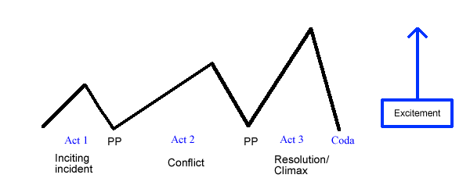
Why do writers usually structure their narratives around conflict?
What does this show us about how human nature is perceived?

Slide 48
What do writers want readers to understand about conflict?
Consider the following possible outcomes of violent conflict and reflect on what writers might see as their roles in society

Slide 49
What alternative ways of resolving conflict are suggested by the following slides?
Write down some words that come to mind when you view these images
How might these outcomes be achieved?

Slide 50
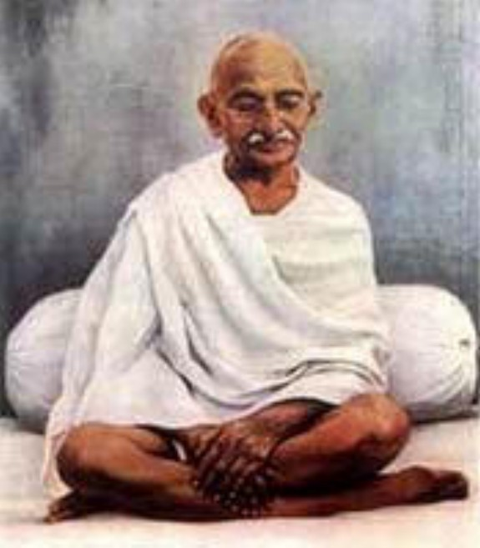

Slide 51
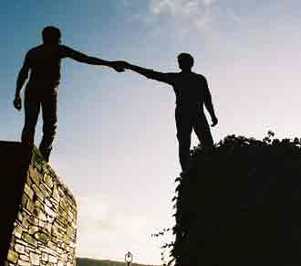

Slide 53
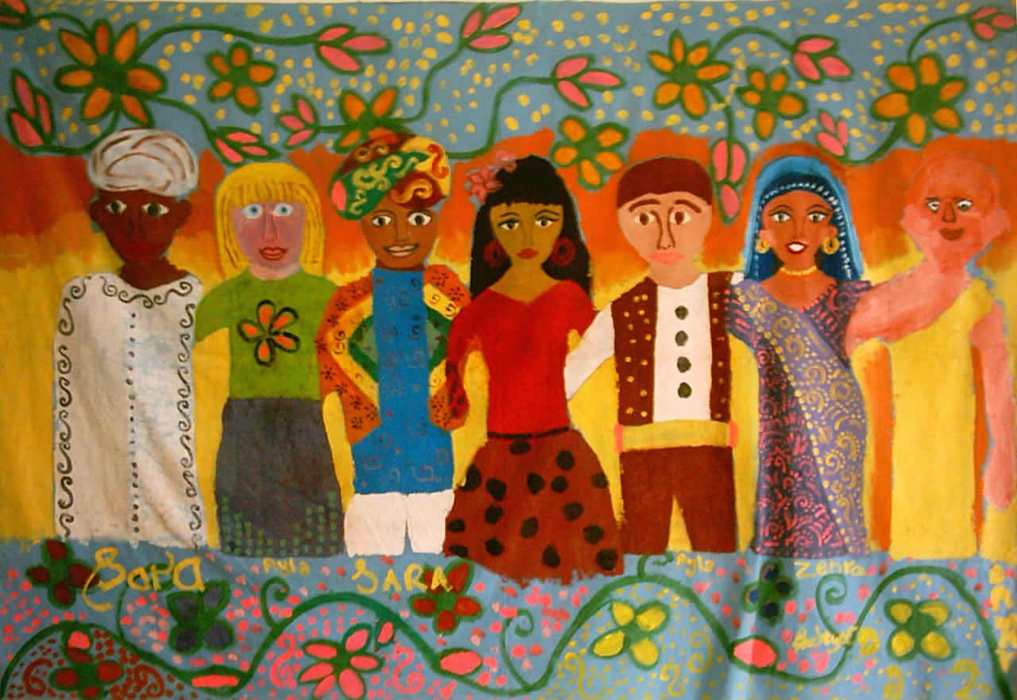

Slide 54
What do we, as readers, take from reading texts about encountering conflict?
Write a brief reflection about conflict, beginning with a significant event in your own life, a current or historical issue and connecting it to an example of conflict in one of the texts you’ve read.

