Slide 1
The Secret Code of Filming Photography
Shots
Angles
Lighting and Colors
The great French critic André Bazin noted that “One way of understanding better what a film is trying to say is to know how it is saying it.”
American critic Herman G. Weinberg agreed, saying “The way a story is told is part of that story. You can tell the same story badly or well: you can also tell it well enough or magnificently. It depends on who is telling the story.”
Theory of organic form: form and content are mutually dependent in any art form.

Slide 2
Textual Analysis of Gattaca
Gattaca was written and directed by Andrew Niccol in 1997.
Tagline: There is no gene for the human spirit.
Plot Outline: Futuristic story of a genetically imperfect man and his seemingly unobtainable goal to travel in space.
Themes:
You cannot let others determine your destiny.
You must be true to yourself in order to succeed.
We must carefully use new technologies, not letting them de-humanize us.

Slide 3
Shots
The different cinematic shots are defined by the amount of subject matter that’s included within the frame of the screen.
In general, shots are defined by how much of the human figure is in the frame.
Most shots fall into six different categories:
The extreme long shot – The long shot
The full shot – The medium shot
The close-up – The extreme close-up

Slide 4
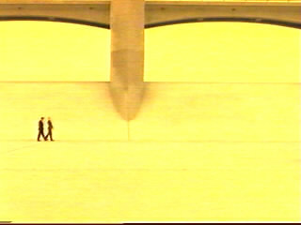
The Extreme Long Shot
This shot is taken from a great distance and so it is nearly always an exterior shot
They serve as spatial frames of reference for closer shots and so are sometimes called establishing shots
This can distance the subject in the frame, making it seem insignificant or powerless
Here Vincent and Irene are very small in comparison to the structures of their society. They are trapped in the frame by the bridge.

Slide 5
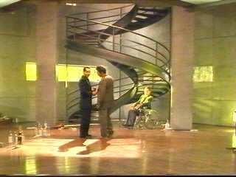
The Long Shot
Long shot ranges correspond approximately to the distance between the audience and live theater.
Like the extreme long shot this can act as an establishing shot and distance the subject from the viewer.
It can provide different planes of visual interest.
Within this frame, Vincent and the broker are clearly in a position of power compared to Jerome, as they are on a nearer plane to the audience. The audience sees how the staircase, itself symbolic, exists in the apartment.

Slide 6
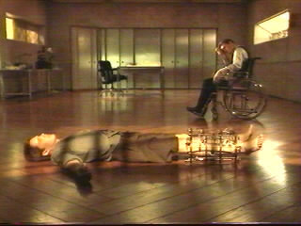
The Full Shot
This is the closest range of long shot, which just barely contains the human body in full.
It can allow you to see the full body and its movement, and even large facial expressions.
This frame is unusual, as it traps Vincent horizontally, just as the surgery immobilizes him. The framing shows us that he is now trapped in his new role as Jerome. There is no escaping, as Jerome’s position in relation to Vincent’s attests. Jerome is now holding a certain power over Vincent.

Slide 7
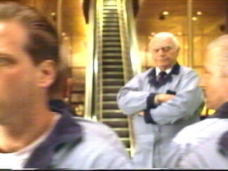
The Medium Shot
This shot contains a figure from the knees or waist up.
It is a functional shot: it carries exposition, dialogue, or movement.
Two variations of the shot are the two-shot and the over-the-shoulder shot.
Two-shot contains two characters or figures
The over-the-shoulder contains two also, usually with one having part or all of his/her back to the camera
In this over-the-shoulder shot the chief janitor acts as a guard, obstructing the viewer’s access to the escalator and thus to Gattaca and Vincent’s and “our” dreams.

Slide 8
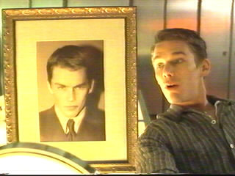
The Close-up Shot
The close-up shows very little locale and concentrates on a relatively small object, such as the human face and its subtle expressions.
The magnification elevates the importance of things, often suggesting a symbolic significance.
This close-up shows Vincent’s pride, surprise, and happiness at his new resemblance to Jerome. To viewers, the portrait is more prominent, hinting at the trouble this will cause for Vincent.

Slide 9
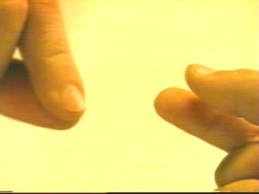
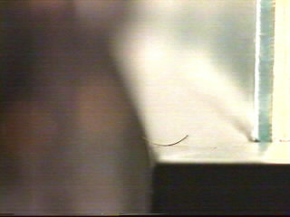
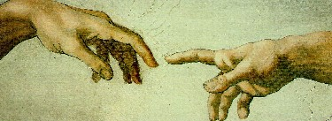
The Extreme Close-up Shot
This is a variation of the close-up. Where a close-up might show the human face, the extreme close-up might show just a person’s eyes, mouth, or, in this case, eyelash.
This shot also allows for symbolism. Here the extreme close-up on the fingers has Irene fully disclosing her true self to Vincent, as her hair symbolizes her true identity and unconditional love. The image of the fingers alludes to Michelangelo’s painting of God and Adam on the Sistine chapel ceiling, as well.

Slide 10
Angles
The angle from which an object is photographed can often serve as an authorial commentary on the subject matter.
The angle is determined by where the camera is placed in relation to the subject.
There are five basic angles:
The bird’s-eye view
The high angle
The low angle
The eye-level shot
The oblique angle
The subject matter can be identical in two different shots, but if the angle from which they are filmed is different, you can have two very different understandings of that subject.

Slide 11
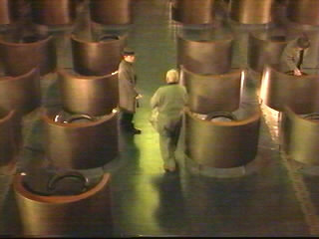
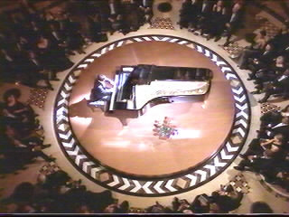
The Bird’s-Eye View
This angle involves photographing a subject from directly overhead.
This can make characters seem powerless and insignificant, ant-like, to viewers. It is a favorite of directors whose themes deal with fate.
Notice that in each of these frames, we see that the janitor and the pianist have become what society expected of them. The angles, as well as the mise en scène, shows us that they are trapped.

Slide 12
High Angles
These are not as extreme as bird’s-eye views and not so disorienting.
The camera is placed on a crane, or some other elevated point, but the sense of omnipotence is not overwhelming.
These angles tend to slow movement and reduce the height of the objects.
The importance of setting is increased as the locale may swallow people.
This angle might be used to capture a character’s self-contempt.

Slide 13
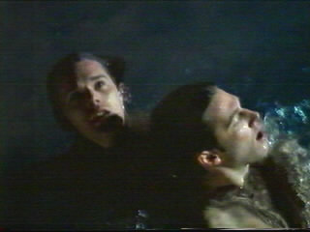
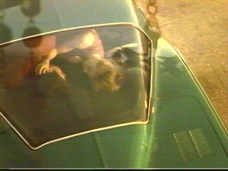
High Angles
In this frame we sense Vincent’s acceptance of not only himself and his abilities but of other people’s worldviews. He is in control of his own destiny.
Likewise, in this early frame, we see Vincent’s parents from a somewhat disturbing angle. They are clearly not in control.

Slide 14
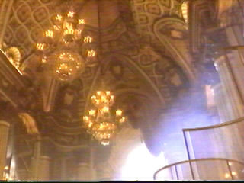
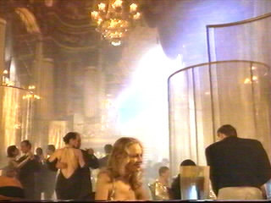
Low Angles
These angles increase height and are useful for suggesting verticality.
They increase a short actor’s height, speed motion up, and minimize the environment.
Psychologically, the subject’s importance is heightened, possibly making the viewer fell threatened, and—especially in violent scenes—increase the sense of confusion.
Here we have a low angle shot that pans down to Vincent and Irene. It lends an optimism that we rarely glimpse in the film.

Slide 15
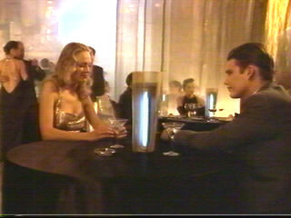
Eye-level Shots
These shots are filmed from eye level, from five to six feet off of the ground, approximately the way an actual observer might view a scene.
Most scenes are filmed this way in most films, as it captures the clearest view of an object and does so most objectively. Therefore, these are used particularly in routine expository scenes.
At the end of the pan from a low level, we pull into Irene and Vincent dining. The effect decreases some of the optimism the low angle shot gave us, and we are back to the reality of the situation. The characters do not know whether to trust each other.

Slide 16
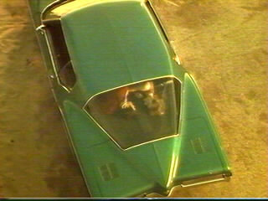
Oblique Angles
These shots involve a lateral tilt of the camera. When the image is projected, the horizon is skewed.
This angle is sometimes used for point-of-view shots, to suggest the imbalance of a drunk, perhaps.
Psychologically, these angles suggest tension, transition, and impending movements. These, too, are often used in violent scenes to create an extreme sense of visual anxiety.
This shot suggests an oblique angle, and since it is the shot where Vincent imagines his parents conceiving him, it shows the tension he feels with their decision to have him, genetically imperfect as he is.

Slide 17
Lighting and Colors
Light and Dark
There are a number of different styles of lighting. Usually described as a lighting key, the style is geared toward the theme and the mood of a film, as well as its genre.
Comedies and musicals tend to be lit in high key, with bright even illumination and few conspicuous shadows.
Tragedies and melodramas tend to be lit in high contrast, with harsh shafts of light and dramatic streaks of blackness.
Mysteries and thrillers are generally done in low key, with diffused shadows and atmospheric pools of light.

Slide 18
Light and Dark
Lights and darks have had symbolic connotations since the dawn of humanity.
In general, artists have used darkness to suggest fear, evil, the unknown.
Light usually suggests security, virtue, truth, joy, or purity.
Lighting can distort or intensify a viewer’s perception of a subject.
A human face lit from below can look sinister, while lit from above an angelic halo effect is produced.
Spotlighting can highlight the significance of an object, as well.

Slide 19
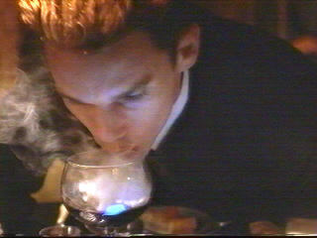
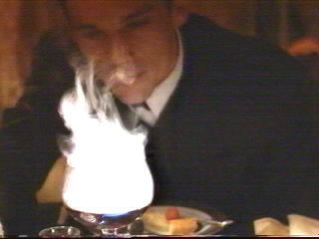
Lighting in Gattaca
Lighting in Gattaca tends to be low key, taking after the film noir genre (literally “black cinema”), a popular type of film in America in the 1940s and early 1950s.
Noir is an urban world of night and shadows; the style is profuse with dark streets, cigarette smoke swirling in dimly lit cocktail lounges, and symbols of fragility, such as window panes, sheer clothing, glasses, and mirrors.
Here the spotlight highlights the smoke in Vincent’s glass, as he explains Titan’s atmosphere to Jerome. The lighting provides the key to the symbolism: Vincent knows something is there, as he knows his own soul. Jerome is not so sure.

Slide 20
Color
Color tends to be a subconscious element in a film. It is strongly emotional and it can alter people’s moods and perceptions.
Color use can be symbolic, just as the use of lighting can be.
Cool colors (blue, green, violet) suggest tranquility, aloofness, and serenity and tend to recede into an image.
Warm colors (red, yellow, orange) suggest aggressiveness, violence, and stimulation and are more dominant in most images.
Red is often a color suggesting danger, violence, or death, perhaps because it is the color of blood.
Black is often the color of villainy or evil.
White is often the color of truth, spirituality, or purity.
Blue can often lend a cold chilling feeling to a scene.
Browns and gold tones can suggest nostalgia.

Slide 21
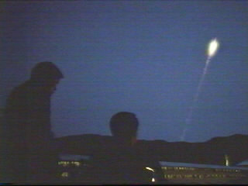
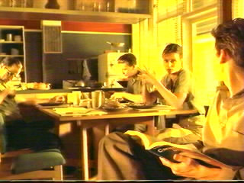
Color in Gattaca
There are two main color cues in Gattaca: blues and amber-gold tones.
The blues are used mainly in the present action of the story
The ambers are used in the flashback- reminiscent scenes and the Vincent/Irene “love” scenes
The colors provide an interesting visual contrast, as well as carrying symbolic weight. Blue, while lending a depressing trapped feeling, seems to represent truth. The amber, although an emotionally warm color, suggests a taint in Vincent’s life.

Slide 22
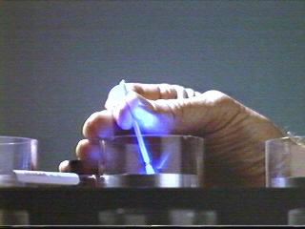
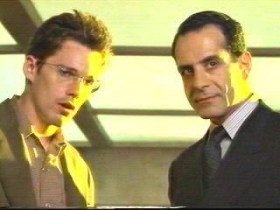
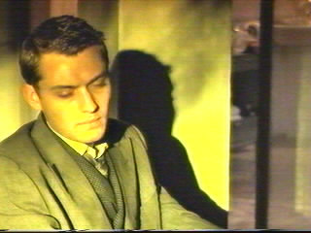
Color in Gattaca
The spotlighting of these two colors advances our understanding of their symbolism.
Here the streaks of gold lighting taint the three people involved with the identity sale. Vincent and the broker are tainted as they literally buy Jerome, forcing him to remain a non-entity in society, trapped by his perhaps faulty views of his own worth.
The blue spotlighting in this extreme close-up exposes the truth of the identity of the director’s murder.

Slide 23
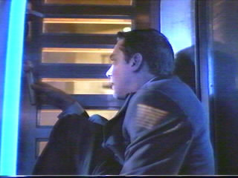
Although Jerome is somewhat trapped by the bars on the shower/incinerator door, he is in a sense finally succeeding at something he set out to accomplish, his death. The truth is that he is finally at peace with himself.
The gold lighting, explained contextually by the fire, turns Jerome’s silver medal to gold, as he finally succeeds. This success is tainted, however, as he is only succeeding at suicide.

Slide 24
The Secret Code of Filming Mise en scène
Contrasts
Character Placements
Elements of Set Composition
Mise en scène (pronounced meez on sen) was originally a French theatrical term meaning “placing on the stage.”
In film, it refers to how the filmmaker arranges the objects and people within the frame of the shot.
Theory of organic form: form and content are mutually dependent in any art form.

Slide 25
Contrasts
The human eye automatically attempts to unify various elements within a composition. In most cases, the eye sees the items individually before integrating them.
The area of an image that most immediately attracts our attention is the dominant contrast, or the dominant. This effect can be achieved through color, spacing, size, movement, and lighting effects.
After we take in the dominant, our eye scans the subsidiary contrasts that the artist has arrange as counter balancing devices.
In this frame, we are drawn to the portrait of Jerome before we see Vincent, which stresses both the tragedy of the loss of Jerome’s identity and Vincent’s moral culpability to us.

Slide 26
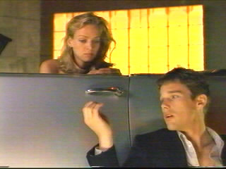
Character Placement Framing: The areas of the frame affect the significance of the subject
The areas to the left and right edges of the frame suggest insignificance, because they are farthest removed from the center.
The area near the top of the frame can suggest ideas dealing with power, authority, and aspiration. A positive character placed there could seem in control of his/her situation, while a negative character placed there could seem threatening.
The areas near the bottom of the frame tend to suggest subservience, vulnerability, and powerlessness.
Irene is in a position of power over Vincent here, as she can decide to either accept or reject him.

Slide 27
Character Placement Proxemics: The distance between the camera and the subjects affects the significance of the subject
Proxemic patterns refer to the relationships of organisms within a given space.
The greater the distance between the camera and the subject the more emotionally neutral we remain to them.
The closer we are to a character, generally speaking, the more emotionally involved we become.
The proxemic distances correspond roughly to the shots.

Slide 28
Character Placement, continued Proxemics: The distance between the camera and the subjects affects the significance of the subject
Intimate Distance
Skin contact to about 18 inches away
This can reflect love, comfort, or tenderness, or suspicion, hostility, and fear, depending on the viewer’s relation to the subject
This corresponds to the close-up and the extreme close-up
We are intimately emotionally involved in this strand of hair’s exchange because of our close distance to it and the fingers’ close distance to each other.

Slide 29
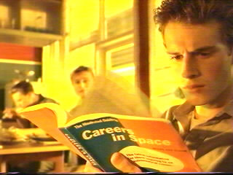
Character Placement, continued Proxemics: The distance between the camera and the subjects affects the significance of the subject
The Personal Distance
18 inches to 4 feet away
These distances tend to be reserved for family and friends, yet do not exclude outsiders as intimate distances do.
The medium shot captures this distance
Vincent’s intimate distance from us separates him from his family, who are at a personal distance, and thus privileges him to us.

Slide 30
Character Placement, continued Proxemics: The distance between the camera and the subjects affects the significance of the subject
The Social Distance
4 feet to 12 feet away
These are distances reserved for impersonal business and casual gatherings.
Full shot ranges corresponds to this distance
The table blocks some of the effect of this near long shot, but the distance between the characters and their seeming distance from us shows us that they have issues of faith and trust to resolve.

Slide 31
Character Placement, continued Proxemics: The distance between the camera and the subjects affects the significance of the subject
Public Distance
12 feet to 25+ feet away
This range suggests detachment and a lack of emotional involvement.
The long shot and the extreme long shot correspond to this distance
We are so distanced from the character that our lack of emotional involvement is disconcerting, but at least we are not involved in the unethical business. The placing of the characters in relation to each other shows the differing power levels between them.

Slide 32
Elements of Set Composition
As most films use created sets, everything in those environments is artificially assembled. It is all purposely placed to provide and contribute to the context of the action and to help the director communicate the film’s theme.
Film Noir is often abounding with visual metaphors of entrapment, such as alleys, tunnels, train cars, etc.
The tone is fatalistic and paranoid, suffused with pessimism, emphasizing the darker aspects of the human condition.
Its subjects characteristically involve violence, lust, greed, betrayal, and depravity.

Slide 33
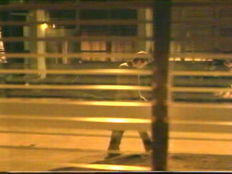
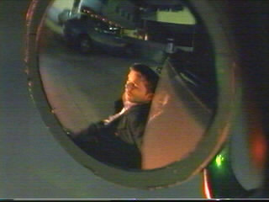
Elements of Set Composition in Gattaca
The costuming, color, and props all give the feel of an example of 1940s Film Noir.
Images of characters entrapped, virtually imprisoned, abound.
These are all images of entrapment with shadows acting as prison bars, cutting the characters off from the world. Even the mirror reflection of Vincent minimizes him in the frame, containing him and separating him from freedom.

Slide 34
Film Noir
Literally “black films,” as termed by the French cinema critical establishment, film noir is a genre of film that flourished in America from 1941-58
Focus on urban crime and corruption and on sudden up-swellings of violence in a culture whose fabric seems to be unraveling
Because of these concerns, film noir seems to be largely about violations:
Vice
Corruption
Unrestrained desire
The abrogation of the American Dream’s promise of hope, prosperity, and safety from persecution.

Slide 35
Film Noir Components
Characters who are motivated by selfishness, greed, cruelty, and ambition and who are willing to lie, frame, double-cross, and kill or have killed
Often fatalistic and have characters doomed to fail
Frequent dark scenes, many at night
Low key (dark, shadowy) lighting
Shots obscured by objects, like venetian blinds
Urban settings

Slide 36
Film Noir Components, continued
Exhibit embittered or cynical moods
Can have compressed or convoluted storylines
Usually, because they were made during the era of the American production code, they will punish any characters who go astray
Have femme fatale character
An attractive, young, worldly woman who thinks fast and is verbally adroit, manipulative, evasive, sexy, dangerous, and perhaps even lethal to the men who succumb to her charms

Slide 37
Historical Context of Film Noir
Changing role of women following WWII
Women were displaced from jobs that they held and performed well during the war
Women’s self-sufficiency probably threatened many men, even the filmmakers
Rejection of the nationalistic films and ideologies of WWII
Rejection of the filmic techniques of the 1930s: brightly lit films shot in a studio
The unsettled times
People experienced a sense of disorientation and lack of identity
after surviving the Great Depression
Seeing the massive casualties, genocide, torture, and atomic clouds of WWII

Slide 38
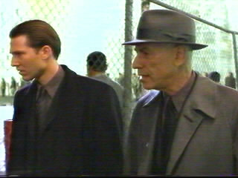
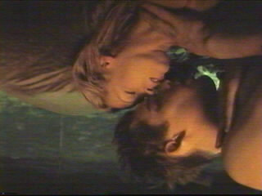
Film Noir Aspects in Gattaca
1.
4.
3.
2.
5.

