Slide 1
Propaganda Techniques
How do you get the masses to follow your policies and desires as a leader or government ?!

Slide 2
What is propaganda?
A way of manipulating people using images, words, and sounds to achieve a desired affect or outcome
Propaganda clouds reality and gets in the way of clear and honest thinking
During wartime, propaganda is designed to provide a focus for our mistrust and hatred, to dehumanize the enemy so they may be killed without remorse

Slide 3
Bandwagon
Hop on the bandwagon or else you don’t fit in.
“Everyone is doing it, so you should too.”
This technique is contrived peer pressure
– no one wants to be left out or behind.

Slide 4
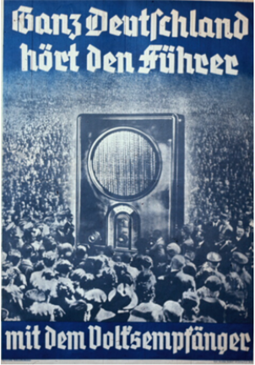
Bandwagon
Everyone listens to the Fuhrer

Slide 5
Testimonial
A celebrity or expert who endorse a product, candidate, or idea.
Think about all of the commercials with celebrities.
The celebrity may not always be qualified to speak on the subject.
Such as…

Slide 6
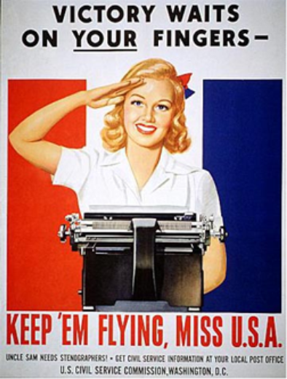
Testimonial

Slide 7
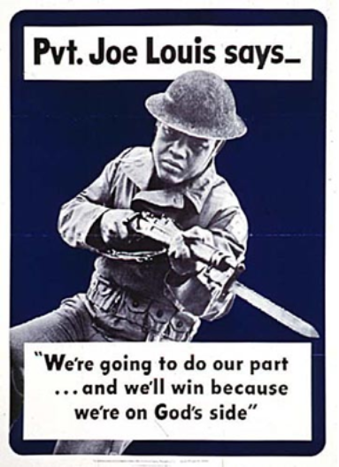
Testimonial

Slide 8
Euphemisms
The use of words or statements that deter from the meaning, to make it not as bad, and more tasteful to the general public.
The Nazis used the term “resettlement” to describe the mass murder of the Jews.

Slide 9
Appeal to Authority
Appeals to authority have important and powerful people supporting a candidate or idea.
Similar to testimonial. But using the leader or other authority figure rather than celebrities.
Such as…

Slide 10
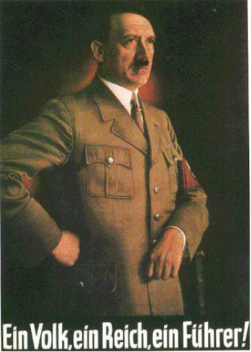
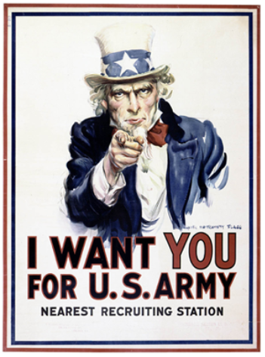
Appeal to Authority
"One People, One Reich, One Führer."

Slide 11
Plain Folks
This technique has a person or cause being associated with regular people.
Candidates who are just like you – they put their pants on one leg at a time too.

Slide 12
Plain Folks
"We are for Adolf Hitler!"

Slide 13
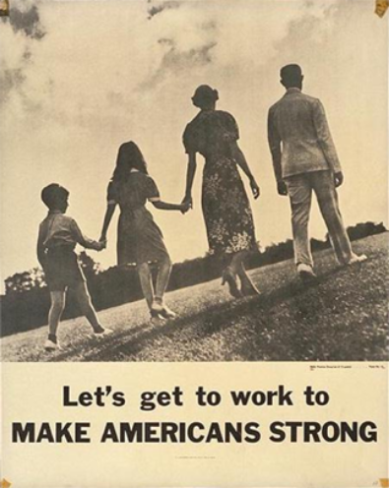
Plain Folks

Slide 14
Transfer
Propagandists transfer the fame, prestige, or reliability of something or someone to an issue that may or may not be related.
Ex: Any politician who publicly says a prayer is transferring religion to their image.
Ex: Use of a flag or patriotic leader is also commonly utilized.
Ex: The Nazis justified treatment of the Jews by “proving” their inferiority through their own science.

Slide 15
Transfer

Slide 16
Logical Fallacies
Drawing a conclusion from a series of premises.
Ex: Religion is good Wars are fought over religion Therefore, religious wars are good.

Slide 17
Fear
During wartime this technique is used often. It informs people that personal danger is imminent if they do or do not do some specific action.
The idea that you are PERSONALLY in danger if you do not comply or conform.

Slide 18
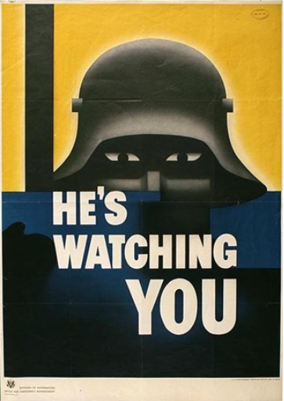
Fear

Slide 19
Glittering Generalities
Use of words and images that generally carry a favorable meaning to everyone; including liberty, democracy, freedom, and civilization. It hopes to associate a person, idea, or group with a positive feeling, but no direct evidence. The largest problem with this technique is that all of these words mean different things to different people.

Slide 20
Glittering Generalities
"Open the door to freedom! Put a strong man at the helm! Out of the swamp! Forward with the powers of renewal!”

Slide 21
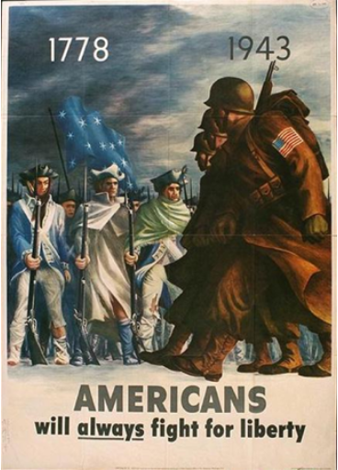
Glittering Generalities

Slide 22
Name-Calling
This technique links a person or idea to a negative image.
It is hoped that association with this negative symbol will cause the viewer to reject it outright.
A derivative of this technique involves carefully selecting descriptive words.
This is the opposite of glittering generalities.

Slide 23
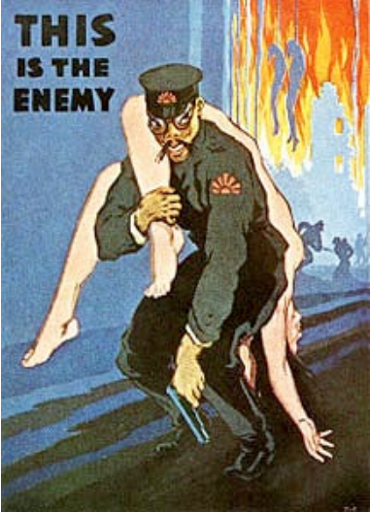
Name-Calling

Slide 24
Name-Calling
“The Jew”
"The inciter of war, the prolonger of war."

Slide 25
Other Techniques *
Misery - Appeals to pity or sympathy to gain support.
Fancy Words - Use of elegant or technical sounding words to persuade and camouflage the truth.
Word Magic - Uses emotional or catchy words to create a positive feeling and makes it easier to remember the idea.

Slide 26
Other Techniques *
Black and White - Presents an issue as having only two choices.
If you don’t like one choice, you must choose the other. No ‘grey’ area.
Simplicity and Repetition - Keep it simple and say it often enough so people will remember it and believe it

