Slide 1
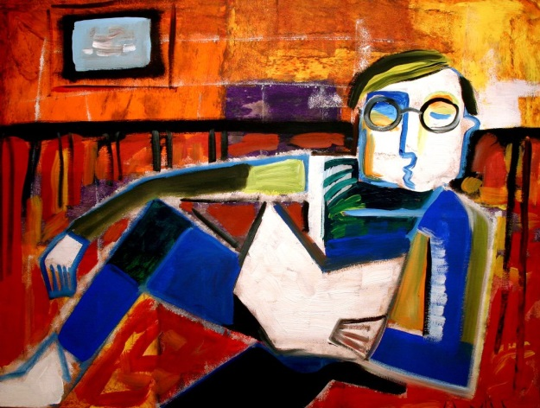
Unit 1 & 2 English Transition 2015-16
An Overview of the Year’s Study

Slide 2
Contents
The year’s programme ;
The works under study in Units 1 & 2 ;
The different Areas of Study ;
Their assessments ;
The semester-end examinations ;
Advice & requirements for a successful Year 11

Slide 3
Course Layout
Unit 1 : Semester One
AOS1 – Reading & Creating Texts
AOS2 - Analysing & Presenting Argument
Unit 2 : Semester Two
AOS1 – Reading & Creating Texts
AOS2 - Analysing & Presenting Argument

Slide 4
Assessment overview
School-Assessed Coursework for Units 1 & 2 will each contribute 100 per cent to the VCAA marks.
The level of achievement for Academic Awards & feedback to students & their parents is also assessed by two end-of-semester examinations. However, their results are not communicated to the official VASS system.
School-Assessed Coursework is marked according to VCAA VCE grading scales.

Slide 5
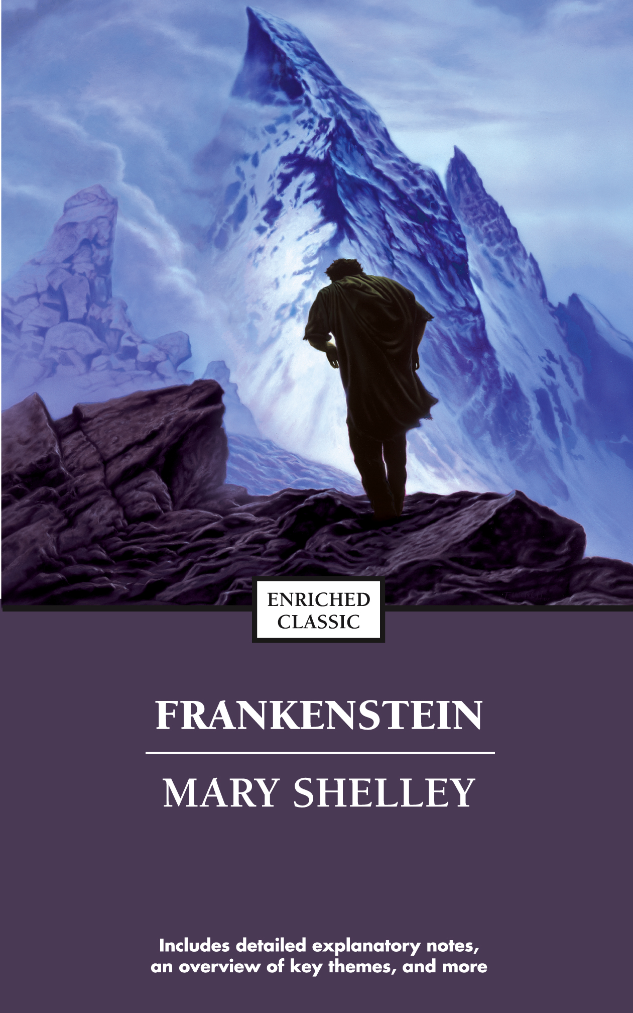
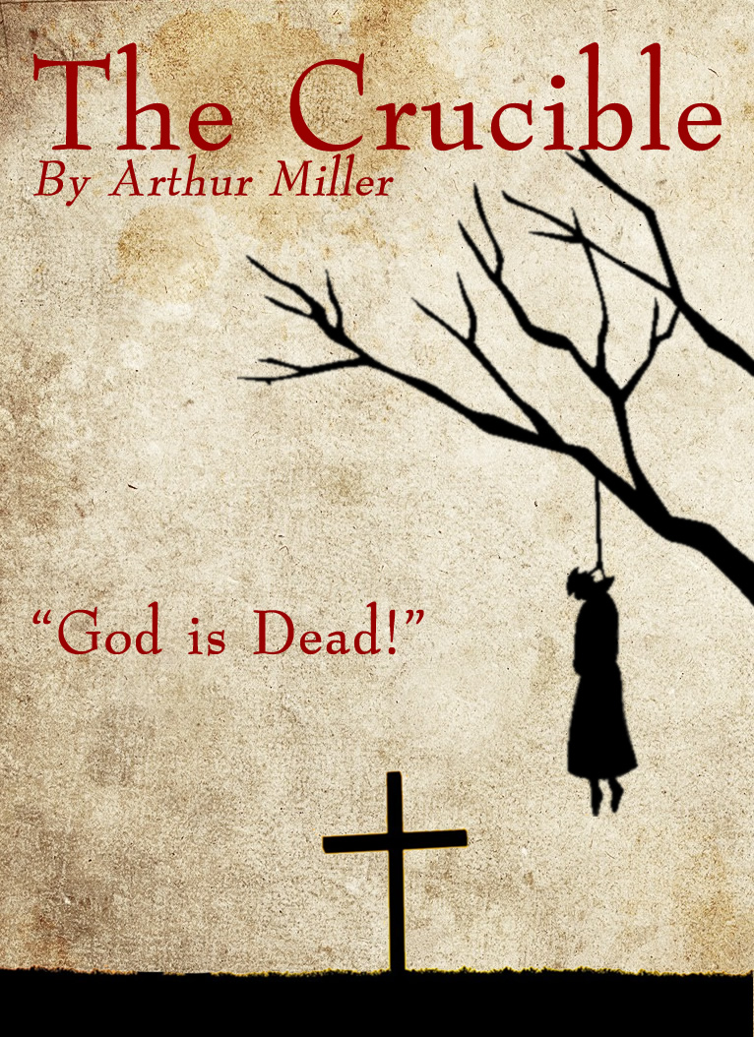
Works Under Study
SEMESTER 1
Gattaca (film)
Frankenstein
SEMESTER 2
A Year of Wonders
The Crucible

Slide 6
UNIT 1
1

Slide 7
AOS1 – Reading & Creating – Single Text Response
In this area of study you explore how meaning is created in a text. You identify, discuss and analyse
decisions authors have made, as well as exploring how authors use structures, conventions and language to represent characters, settings, events, explore themes, and build the world of the text for the reader.

Slide 8
Gattaca – Andrew Niccol dir
In a future world where one’s future is decided by predictive genetic tests, there is one set of opportunities for those who are engineered to be as perfect as possible, and another for those who are naturally born.

Slide 9
AOS1 – Assessment SAT
Text Response Essay – TEEL structure
This SAT will assess an essay form which you have been learning to write for some time now. Throughout Year 11, you will perfect your techniques to form a contention in response to a prompt, set up a four-paragraph structure and use evidence from the text as a basis for your analysis of the authorial intention, views & values, themes & ideas, structure and characterisation of the text. Obviously, since this is a film text, you will also need to analyse visual & audible elements.

Slide 10
AOS1 – Reading & Creating – Creative Response
In developing creative responses to texts, you explore how purpose and audience affect the choices they make as writers in developing ideas and planning work, making choices about structure, conventions, and language to develop voice and style. You practise the skills of revision, editing and refining for accuracy and stylistic effect.

Slide 11
Frankenstein – Mary Shelley
Frankenstein follows Victor Frankenstein’s triumph as he reanimates a dead body, and then his guilt for creating such a thing. When the “Frankenstein monster” realizes how he came to be and is rejected by mankind, he seeks revenge on his creator's family to avenge his own sorrow. Mary Shelley first wrote Frankenstein as a short story after the poet Lord Byron suggested his friends each write a ghost story. The story so frightened Byron that he ran shrieking from the room.

Slide 12
AOS1 – Assessment SAT
Creative Response –
Your Creative Response to Frankenstein is a new task for next year. It can take the form of a monologue, script, short story or illustrated narrative, as appropriate to the text. The most important aspect of this task is that you capture the voice and style of the author, having studied this closely.

Slide 13
AOS2 – Analysing & Presenting Argument
In this area of study you focus on the analysis and construction of texts that attempt to influence an audience.
You will read a range of texts that attempt to position audiences in a variety of ways, exploring the use of language for persuasive effect and the structure and presentation of argument.
This includes considering the contention of texts, the development of the argument including logic and reasoning,
tone and bias and the intended audience.
Finally, you consider how authors craft texts to support and extend the impact of an argument.
To make a presentation of argument in oral form, you also learn about the conventions of oral communication for persuasive purposes. You consider the persuasive impact of tone, diction and audience engagement in the presentation of a viewpoint.

Slide 14
AOS2 – Assessment SAT - Oral
The first SAT of the year will be a Persuasive Oral Presentation.
You will spend 4 – 6 minutes persuading an audience of your peers to believe your contention on an issue of your choice.
The value of creating your own persuasive spoken text is that this process will help you to understand persuasive language from within, and as a result, you will be better placed to analyse another writer’s text.

Slide 15
AOS2 – Assessment SAT – Single Language Analysis
This SAT will focus on how the language used in one document effectively positions its intended readers to follow the writer’s contention on an issue.
In term, you will analyse more than one text, but we start you off with one, while you are perfecting your analytical technique.

Slide 16
UNIT 2
2

Slide 17
A Year of Wonders – Geraldine Brooks
The novel is written from the point of view of a housemaid named Anna Frith, on what she lives through when the plague hits her village. It is based on the history of the small Derbyshire village of Eyam that, when beset upon by the bubonic plague in 1666, quarantined itself in order to prevent the disease from spreading further. The Plague that hit Eyam is historically similar to the Black Plague in Europe.

Slide 18
The Crucible – Arthur Miller
In the town of Salem, a group of teenage girls, led by Abigail Williams, accuse women and men of witchcraft. One man, John Proctor, has had an affair with Abigail, and he now thinks that Abigail is causing trouble because she is jealous of his wife. The efforts of the court to find out the truth are swayed by the hysteria that the girls create in the court room. The judge chooses to believe the girls' stories, to save the reputation of the court, and many innocent townspeople are executed, including John Proctor.

Slide 19
AOS1 – Assessment SAT Comparative Text Response
This Text Response essay will look for ways in which both A Year of Wonders and The Crucible present common (and possibly divergent) view & values, themes & ideas and evern characterisation and structure.

Slide 20
AOS2 – Assessment SAT – Comparative Language Analysis
This SAT will focus on how the language used in two to three documents effectively positions its intended readers to follow the writer’s contention on an issue.
This Comparative Analysis has been the selected Language Analysis type in the VCE examination over the last two years.

Slide 21
Examinations
The Semester One examination will be comprised of a Text Response on one text, followed by a Single Language Analysis.
The Semester Two examination will be composed of a Comparative Text Response, as well as a Comparative Language Analysis.

Slide 22
Final Advice for Success I
Read the texts thoroughly & aim to have them read twice before we start on them in class ;
Ensure that you are aware of the criteria for assessment from the start of each unit ;
Study guides can be helpful, but don’t replace your own detailed knowledge of the text ;
Never forget that any text began with its creator having an idea that they were interested in exploring; its function is to explore that idea and everything you read or see is the result of conscious choices.

Slide 23
Final Advice for Success II
Set up a study timetable for all subjects, including work and extra-curricular activities ;
Establish a study group so that you can share the work & bounce ideas off each other ;
In class, be ready to participate & enrich the discussion ;
Always have your text(s) at every class ;
Take notes independently
Ask for help as soon as you need it – not just before the SAT!
Do extra reading including guides, reviews, websites etc – they really do help!

Slide 24
Have a fantastic Year 11!

